Slide 1
Job Prospects for Computer Science Projections
CS 480
TECHNOLOGY
Austin Bennett & Andrew
P

Slide 2
About Global Technology Project Proposal Infographics
This template contains an assortment of complementary infographic resources for the Global Technology Investments Project Proposal presentation.
These infographics are adapted to the style of the aforementioned presentation, so you can insert them easily and have them completely integrated at once. You just need to do the following:
  Select the element that you want to copy
  Right-click and choose “Copy”
  Go to the slide where you want the element to appear
  Right-click and choose “Paste”

Slide 3
Global Technology
Mars a very cold place
Mercury is the closest planet
Saturn has several rings
Mars
Mercury
Saturn
Venus
Jupiter
Neptune
Venus has a beautiful name
Jupiter is the biggest planet
Neptune is the farthest planet

Slide 4
Global Technology
9,586
Mars
Mars is a cold place
2,670
Mercury
Mercury is the closest
12,098
Saturn
Venus has a beautiful name and is the second planet from the Sun. It’s terribly hot, even hotter than Mercury
Saturn has rings

Slide 5
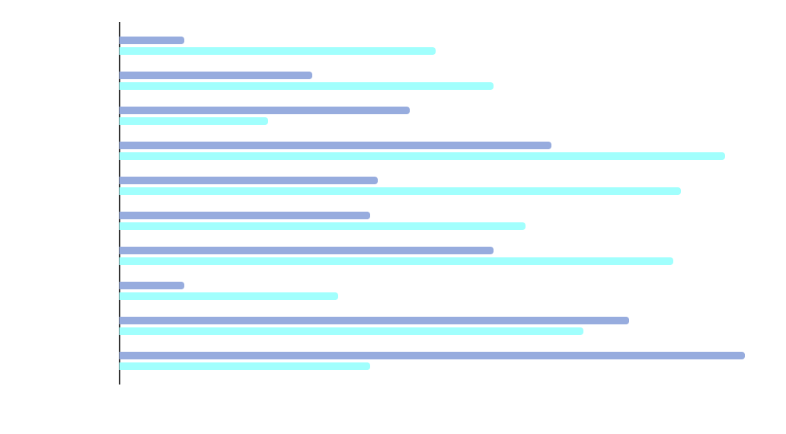
Global Technology
Mars
Mars is actually a very cold place
Mercury
Mercury is actually the closest planet
* Follow the link in the graph to modify its data and then paste the new one here. For more info, click here

Slide 6
Global Technology
10%
40%
20%
30%
+
+
+
Mars
Mercury
Saturn
Venus
Mars is actually a very cold place
Mercury is actually the closest planet
It’s composed of hydrogen and helium
Venus is the second planet from the Sun

Slide 7
Global Technology
Area | Topic | Description | Investment
Area 1 | Mars | Mars a very cold place | $2,458
 | Mercury | Mercury is the closest planet | $3,486
 | Saturn | Saturn has several rings | $1,780
Area 2 | Venus | Venus is the second planet | $5,289
 | Jupiter | Jupiter is the biggest planet of them all | $980

Slide 8
Global Technology
Before
vs
After
Mars
20%
A
80%
Venus
It is a cold place
It is the second
Mercury
70%
B
30%
Jupiter
It is the closest
It is the biggest
Saturn
40%
C
60%
Neptune
Saturn has rings
It is the farthest

Slide 9
Global Technology
Mars
Neptune
Mars is a cold place
50%
Neptune is the farthest
Mercury
Mercury is the closest
Saturn
Jupiter
Saturn has rings
50%
Jupiter is a gas giant
Venus
Venus is the second

Slide 10
Global Technology
Mars
Mercury
Saturn
Despite being red, Mars is actually a cold place. It’s full of iron oxide dust
Mercury is the closest planet to the Sun and the smallest of them all
Saturn is a gas giant. It’s composed mostly of hydrogen and helium
Feature 1
Feature 2
Feature 3
Feature 4
Feature 5
Feature 1
Feature 2
Feature 3
Feature 4
Feature 5
Feature 1
Feature 2
Feature 3
Feature 4
Feature 5
Investment
Investment
Investment
$3,468
$3,468
$3,468

Slide 11
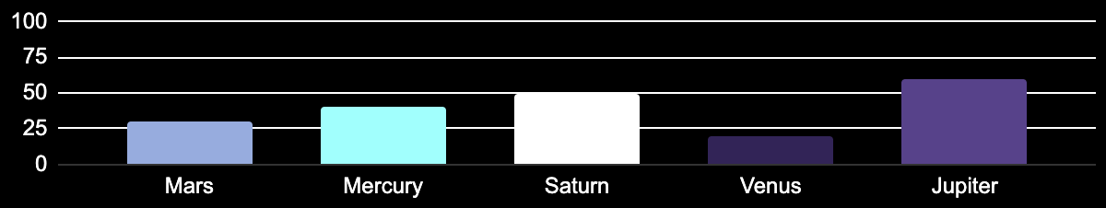
Global Technology
Mars
Mercury
Saturn
Mars is a cold place
Mercury is the closest
Saturn has rings
Venus
Jupiter
Venus is the second
Jupiter is the biggest
* Follow the link in the graph to modify its data and then paste the new one here. For more info, click here

Slide 12
Global Technology
Area
Mars | Mars is actually a very cold place
Investment | $7,987
Area
Mercury | Mercury is the closest planet
Investment | $5,294
Area
Saturn | Saturn is a gas giant and has rings
Investment | $3,672
Area
Venus | Venus is the second planet
Investment | $4,298

Slide 13
Global Technology
1
2
3
4
5
Mars
Mercury
Saturn
Venus
Jupiter
Mars is actually a very cold place
Mercury is actually the closest planet
It’s composed of hydrogen and helium
Venus is the second planet from the Sun
Jupiter is the biggest planet of them all

Slide 14
Global Technology
Mars
25%
Mars is actually a very cold place
Mercury
50%
Mercury is actually the closest planet
Saturn
75%
It’s composed of hydrogen and helium
Venus
90%
Venus is the second planet from the Sun

Slide 15
Global Technology
Mars
Venus
Mars is a cold place
Venus is the second
Mercury
Jupiter
Mercury is the closest
Jupiter is the biggest
Saturn
Neptune
Saturn has rings
Neptune is the farthest

Slide 16
Global Technology
Mon | Tue | Wed | Thu | Fri | Sat | Sun
1 | 2 | 3 | 4 | 5 | 6 | 7
8 | 9 | 10 | 11 | 12 | 13 | 14
15 | 16 | 17 | 18 | 19 | 20 | 21
22 | 23 | 24 | 25 | 26 | 27 | 28
29 | 30 | 31
Mars
Mercury
Saturn
Mars is a cold place
Mercury is the closest
Saturn has rings

Slide 17
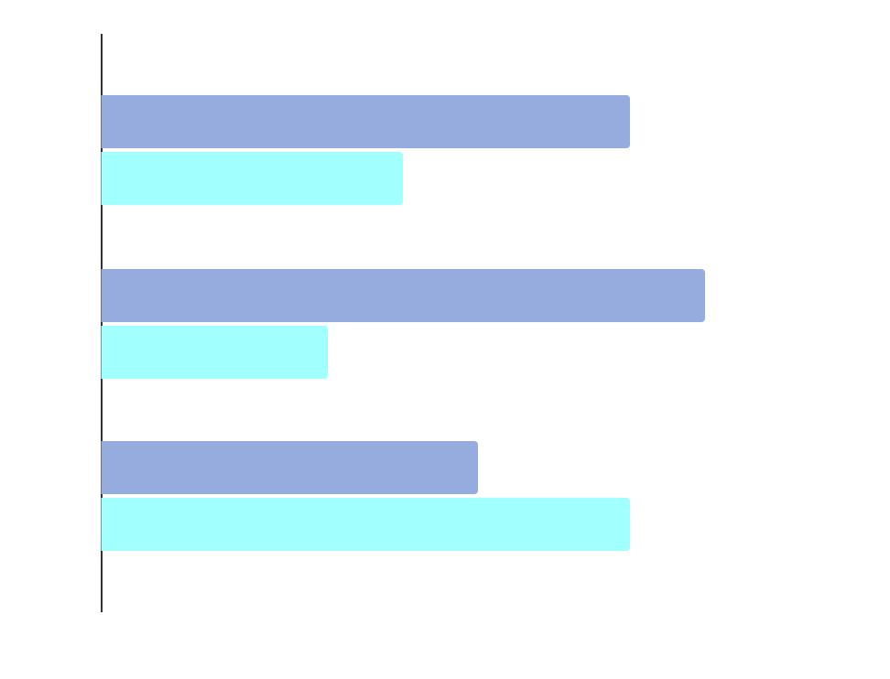
Global Technology
70%
30%
Mars
Mercury
Mars is a very cold place
Mercury is the closest planet
* Follow the link in the graph to modify its data and then paste the new one here. For more info, click here

Slide 18
Global Technology
$23,049
$56,797
Mars is cold
Mercury is small
80%
Venus
Saturn is a gas giant and has several rings. It’s composed mostly of hydrogen and helium. It was named after the Roman god of wealth and agriculture
Venus is the second
50%
Jupiter
Jupiter is the biggest
Conclusions
60%
Neptune
List of conclusions
List of conclusions
List of conclusions
Neptune is the farthest

Slide 19
Global Technology
Mars
Mars is a cold place
Mercury
Mercury is the closest
Saturn
Venus
Jupiter
Saturn has rings
Venus is the second
Jupiter is the biggest
Project 1
Project 1
Project 1
Project 2
Project 2
Project 2

Slide 20
Global Technology
Value B
Mars
High
Mars is actually a cold place
Mercury
Mercury is the closest planet
Value A
Saturn
Low
High
It’s composed mostly of hydrogen
Venus
Low
Venus has a beautiful name

Slide 21
Global Technology
Mercury | Mercury is the closest planet to the Sun | Yes
Mars | It is actually a cold place | No
Saturn | It is a gas giant and has several rings | Yes
Venus | Venus has a beautiful name | No
Jupiter | It’s a giant and the biggest planet | No
Neptune | Neptune is the farthest planet from the Sun | Yes

Slide 22
Global Technology
Start
0%
Venus
Venus has a beautiful name
2XXX
50%
Saturn
It’s composed of hydrogen
2XXX
75%
Mercury
Mercury is the closest
End
100%
Mars
Mars is actually a cold place

Slide 23
Global Technology

Slide 24
Global Technology
Task list
To do list | Done
To do list
To do list | Done
To do list | Done
To do list
To do list | Done
To do list
Neptune is the farthest planet from the Sun. It’s also the fourth-largest planet by diameter in the Solar System
3/5
Mars
Despite being red, Mars is actually a cold place
2/5
Mercury
Mercury is the closest planet to the Sun and the smallest
4/5
Saturn
Saturn is a gas giant and has several rings

Slide 25
Global Technology
Investment | Daily | Monthly | Annually
$23,677 | 10% | 30% | 80%
$67,215 | 15% | 25% | 70%
$90,297 | 20% | 40% | 50%
$15,289 | 25% | 55% | 60%

Slide 26
Global Technology
A
Mercury
Saturn
Venus
Mars
Mercury is actually the closest planet
Saturn is composed mostly of hydrogen
Venus has a beautiful name, but it’s terribly hot
Mars is actually a cold place
B
Jupiter
1
2
3
Jupiter doesn’t have a solid surface

Slide 27
Global Technology
30%
Mars
10%
Mercury
70%
Mars is a very cold place
90%
Mercury is the closest planet
60%
Saturn
50%
Venus
40%
It’s composed of hydrogen
50%
Venus is the second planet

Slide 28
Global Technology
Mars
30%
Mars
Venus
Mars is actually a very cold place
Venus is the second planet from the Sun
Venus
70%
Mercury
50%
Mercury
Saturn
Mercury is actually the closest planet
It’s composed of hydrogen and helium
Saturn
90%

Slide 29
Global Technology
2345
576
28
7
2XXX
2XXX
2XXX
2XXX
Mars is actually a very cold place
Mercury is actually the closest planet
Saturn is a gas giant and has several rings
Venus is the second planet from the Sun

Slide 30
Global Technology
Mercury is the closest planet to the Sun and the smallest one in the Solar System. This planet’s name has nothing to do with the liquid metal
Venus has a beautiful name and is the second planet from the Sun. It’s terribly hot, even hotter than Mercury, and its atmosphere is extremely poisonous
Activity | T1 |  | T2 |  | T3 |  | T4
Month 1 |  | 2/3 |  | 1/3 |  | 2/3 |  | 2/3
Month 2 |  | 2/3 |  | 3/3 |  | 1/3 |  | 3/3
Month 3 |  | 1/3 |  | 2/3 |  | 3/3 |  | 1/3

Slide 31
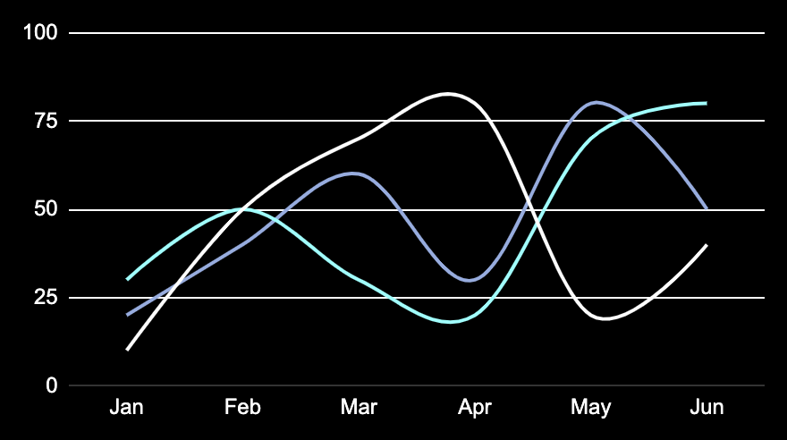
Global Technology
Jupiter
Jupiter is a gas giant and the biggest planet
Saturn
Saturn is a gas giant and has several rings
Neptune
Neptune is the farthest planet from the Sun
* Follow the link in the graph to modify its data and then paste the new one here. For more info, click here

Slide 32
Global Technology
It’s composed of hydrogen
Saturn
Mercury is the closest planet
Venus is the second planet
Mercury
Venus
Mars is a very cold place
Jupiter is the biggest planet
Mars
Jupiter

Slide 33
Instructions for use
If you have a free account, in order to use this template, you must credit Slidesgo in your final presentation. Please refer to the next slide to read the instructions for premium users.
As a Free user, you are allowed to:
- Modify this template.
- Use it for both personal and commercial projects.
You are not allowed to:
- Sublicense, sell or rent any of Slidesgo Content (or a modified version of Slidesgo Content).
- Distribute Slidesgo Content unless it has been expressly authorized by Slidesgo.
- Include Slidesgo Content in an online or offline database or file.
- Offer Slidesgo templates (or modified versions of Slidesgo templates) for download.
- Acquire the copyright of Slidesgo Content.
For more information about editing slides, please read our FAQs or visit our blog:
https://slidesgo.com/faqs and https://slidesgo.com/slidesgo-school

Slide 34
Instructions for use (premium users)
As a Premium user, you can use this template without attributing Slidesgo.
You are allowed to:
Modify this template.
Use it for both personal and commercial purposes.
Share this template in an editable format with people who are not part of your team.
You are not allowed to:
Sublicense, sell or rent this Slidesgo Template (or a modified version of this Slidesgo Template).
Distribute this Slidesgo Template (or a modified version of this Slidesgo Template) or include it in a database or in any other product or service that offers downloadable images, icons or presentations that may be subject to distribution or resale.
Use any of the elements that are part of this Slidesgo Template in an isolated and separated way from this Template.
Register any of the elements that are part of this template as a trademark or logo, or register it as a work in an intellectual property registry or similar.
For more information about editing slides, please read our FAQs or visit our blog:
https://slidesgo.com/faqs and https://slidesgo.com/slidesgo-school

Slide 35
Infographics
You can add and edit some infographics to your presentation to present your data in a visual way.
Choose your favourite infographic and insert it in your presentation using Ctrl C + Ctrl V or Cmd C + Cmd V in Mac.
Select one of the parts and ungroup it by right-clicking and choosing “Ungroup”.
Change the color by clicking on the paint bucket.
Then resize the element by clicking and dragging one of the square-shaped points of its bounding box (the cursor should look like a double-headed arrow). Remember to hold Shift while dragging to keep the proportions.
Group the elements again by selecting them, right-clicking and choosing “Group”.
Repeat the steps above with the other parts and when you’re done editing, copy the end result and paste it into your presentation.
Remember to choose the “Keep source formatting” option so that it keeps the design. For more info, please visit our blog.

